Slide 1

SAPM ASSIGNMENT
GROUP 11

Slide 2
GROUP 11
Priyansh Goyal | 2020A4PS1879H
Raghav Krishna Regalla | 2020B3PS1382H
Sridhara Sri Rama Jayanth | 2020A4PS2299H
G.Karunya Varma | 2020A4PS2244H
Sai Aravind Inkollu | 2020A4PS2308H
Lingutla Sai Charan | 2020A7PS1296H
Nandiraju Venkata Sai Kartik | 2020A4PS1998H
Yogeswar P | 2020A4PS1908H
Manas Kumar Khandwal | 2020A4PS2272H
P B V Shivani | 2020A5PS2543H

Slide 3
BACKGROUND
An asset is a resource with economic value that an individual, corporation, or country owns or controls with the expectation that it will provide a future benefit.
Least Correlated Assets : HINDALCO & NESTLE

Slide 4
BACKGROUND
Keeping our goal in mind of maximizing profit for the long term with minimizing our risk, we picked strong companies from different sectors to diversify our portfolio based on their returns. We have taken 20 Assets. These assets were chosen from high-growth sectors (For example, under FMCG, we have Nestle India Ltd and ITC Ltd).
But, from our analysis done on these assets, we selected the assets which were outperforming their respective sector companies. In doing so, we found out few assets, though from different sectors, had a high correlation coefficient.

Slide 5
LIST OF ASSETS
DLF Ltd
Adani Ports & SEZ Ltd
Asian Paints Ltd
BITCOIN
Dr Reddy's Laboratories Ltd
Gujarat Alkalies & Chemicals Ltd
Hindustan Aeronautics Ltd
HINDALCO Industries Ltd
Infosys Ltd
ITC Ltd
Nestlé India Ltd
Jindal Steel & Power Ltd
L & T Infotech
Mahindra & Mahindra Ltd
MRF Ltd
RIL
Bharat Electronics Ltd
HDFC Ltd
TATA Motors Ltd
TCS Ltd

Slide 6
MARKOWITZ PORTFOLIO THEORY
Assumptions:
Investors believe every investment alternative has a probability distribution of expected returns over a defined holding period.
Risk of the portfolio is gauged based on variability of expected returns
For a given expected return, investors prefer less risk to more risk and for a given risk, they prefer higher returns to lower returns.

Slide 7

MARKOWITZ PORTFOLIO THEORY
The Efficient Frontier is a set of portfolios with the maximum rate of return for every given level of risk, or the minimum risk for every level of return.
Given Risk, Max Return
${max⁡(u}_{px})=x^{1}u$ (subjected to x1,x2,x3)
$σ_{px}^{2}=x^{′}\sum{x} ; x^{1}1=1$
For a Target Return, Min Risk
${min⁡(σ}_{px}^{2})=x^{′}Σx$ (subjected to x1,x2,x3)
$u_{px}=x^{1}u ; x^{1}1=1$

Slide 8
MARKOWITZ PORTFOLIO THEORY Vs MARKET MODEL
For n risky assets, MPT requires a total of 2n + (n2-n)/2 parameters,
while Market Model requires only 3n + 2 parameters.
This is a major limitation of MPT as more number of parameters lead to more assumptions which has adverse effects, especially when dealing with volatile markets.

Slide 9

HISTORICAL DATA ANALYSIS (EXCEL)

Slide 10
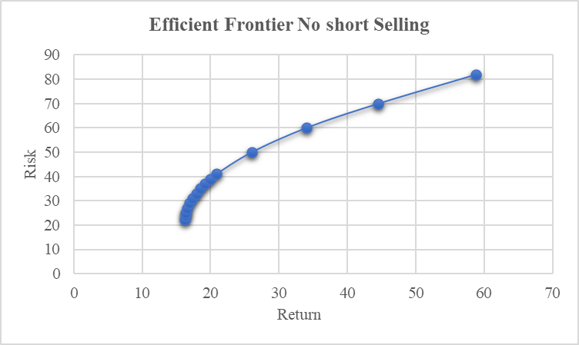
NO SHORT SELLING
The graph shows the Efficient Frontier when Short Selling is not allowed.

Slide 11
Minimum Variance Portfolio (MVP)
Expected Return = 22.06%
Risk = 16.25%

Slide 12
Asset Allocation
Asian Paints =4.57%
TCS = 16.69%
Infosys = 2.33%
HAL = 9.1%
Dr Reddy's = 16.34%
HDFC = 0.006%
ITC = 14.2%
Nestle = 20.57%
BITCOIN = 5.7%
L & T = 0.3%
MRF = 10.05%

Slide 13
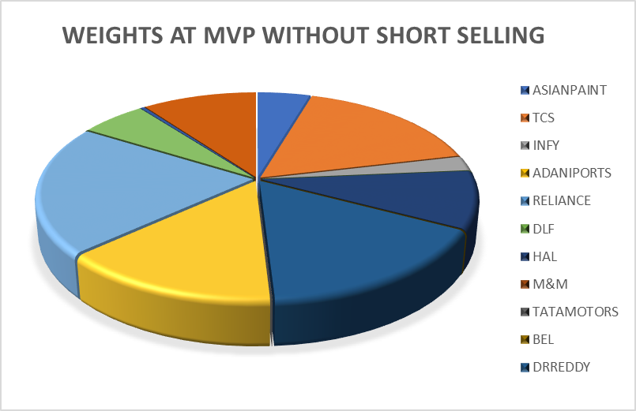
GRAPHICAL REPRESENTATION OF WEIGHTS

Slide 14
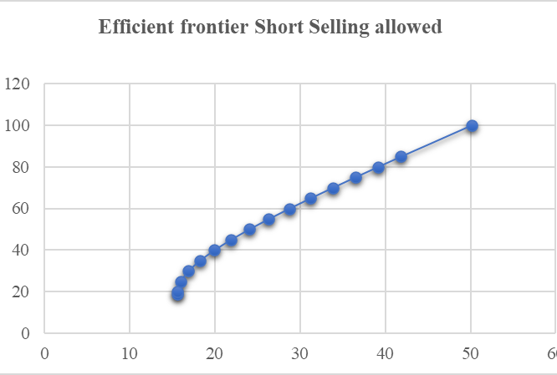
WITH SHORT SELLING
The graph shows the Efficient Frontier when Short Selling is allowed.

Slide 15
Minimum Variance Portfolio (MVP)
Expected Return=18.94%
Risk = 15.60%

Slide 16
Asset Allocation
Asian Paints =4.26%
TCS = 17.26%
Infosys = 3.33%
ADANI = 0.85%
Reliance = 0.81%
DLF = -5.00%
HAL= 10.23%
M & M = 3.26%
Hindalco = -2.12%
Jindal = -5.05%
HDFC = 4.05%
TATA Motors = =3.55%
BEL = 0.72%
Dr Reddy's = 17.02%
GUJALKALI = -1.44%
ITC = 16.04%
Nestle = 19.36%
BITCOIN = 5.45%
L & T = 0.88%
MRF = 13.64%

Slide 17
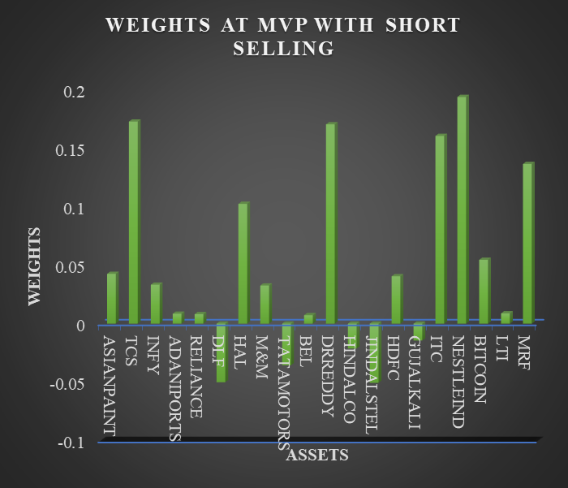
GRAPHICAL REPRESENTATION OF WEIGHTS

Slide 18
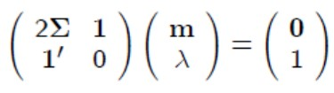

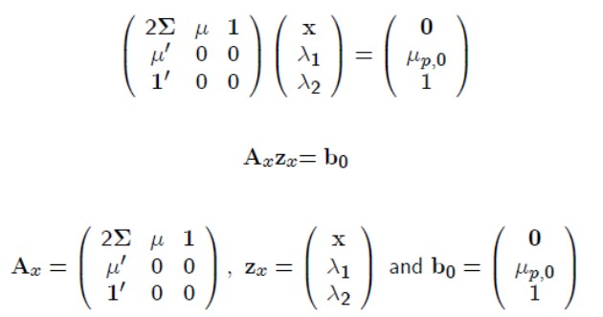

USING MATRIX MULTIPLICATION IN EXCEL

Slide 19
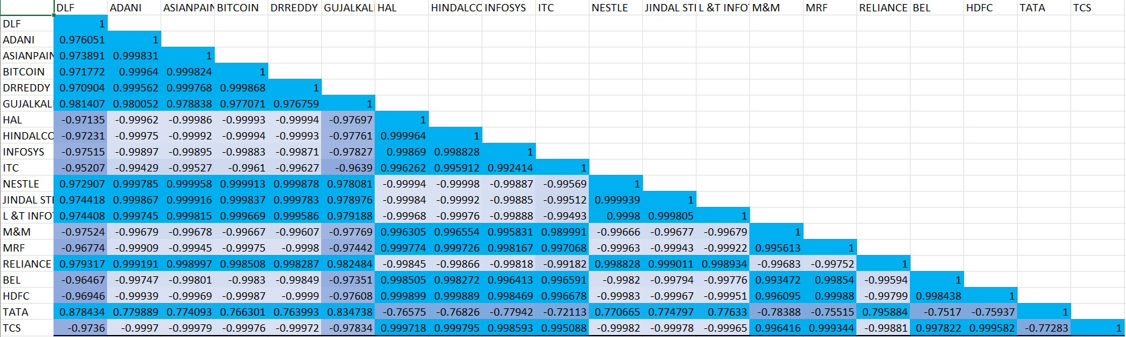
CORRELATION MATRIX

Slide 20
HISTORICAL DATA ANALYSIS (USING PYTHON)

Slide 21
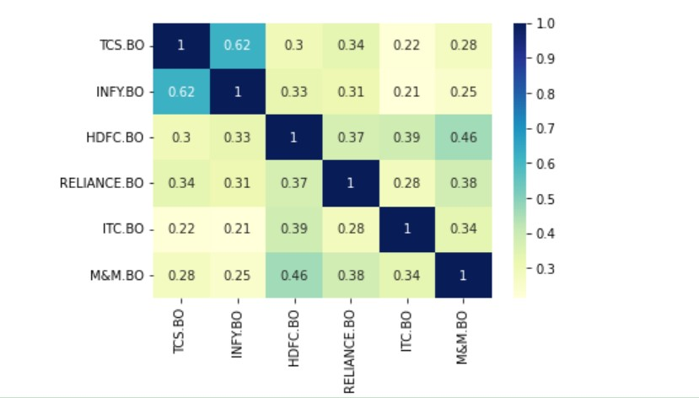
PYTHON RESULTS
Heatmap of Variance Covariance Matrix deduced from Python Code file

Slide 22
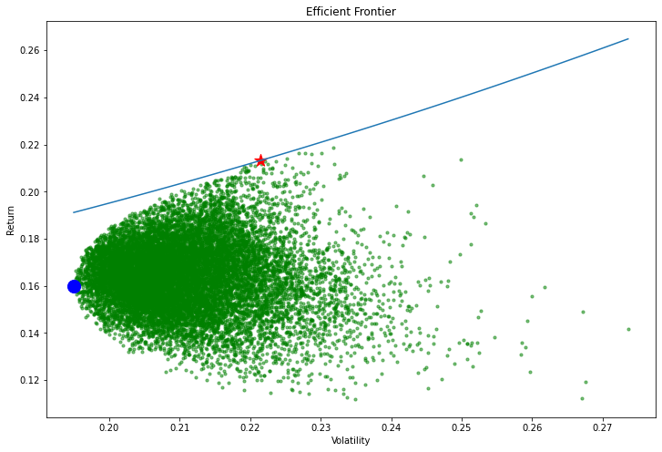
EFFICIENT FRONTIER

Slide 23
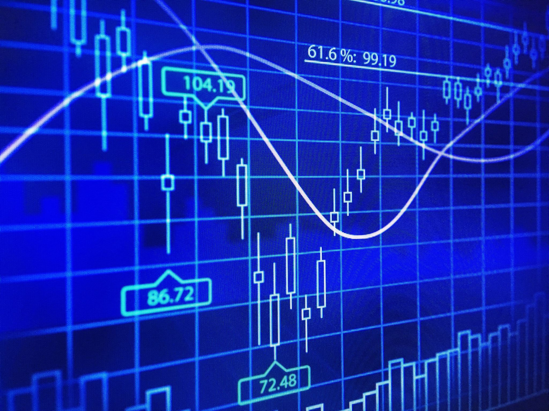
MARKET MODEL ANALYSIS (EXCEL)

Slide 24
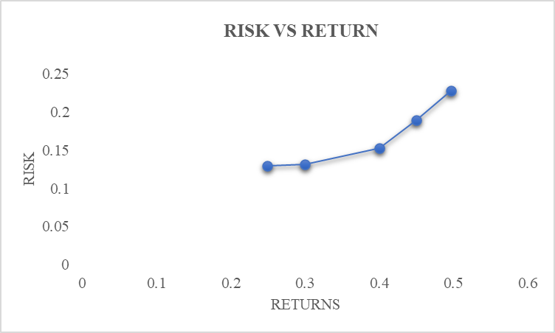
NO SHORT SELLING
The graph shows the Efficient Frontier when Short Selling is not allowed.​

Slide 25
Minimum Variance Portfolio (MVP)
Expected Return = 24.95%
Risk = 12.96%

Slide 26
Asset Allocation
TATA =73.49%
TCS = 3.46%
Infosys = 9.605%
HAL = 3.76%
M & M = 4.26%
Hindalco = 0.00008292116%
BITCOIN = 5.42%
REMAINING=0%

Slide 27
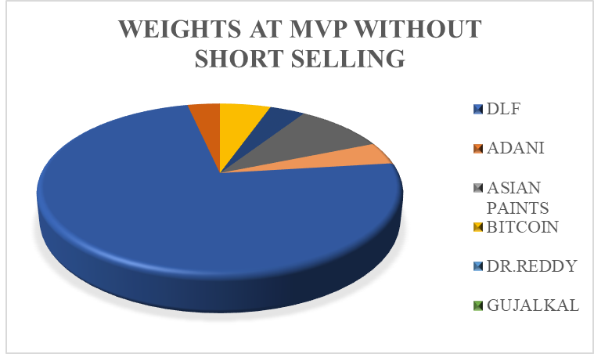
GRAPHICAL REPRESENTATION OF WEIGHTS

Slide 28
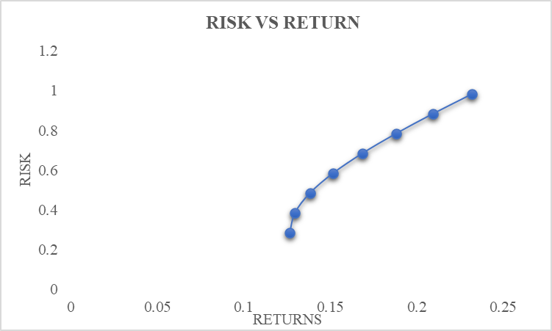
WITH SHORT SELLING
The graph shows the Efficient Frontier when Short Selling is allowed.

Slide 29
Minimum Variance Portfolio (MVP)
Expected Return = 11.84%
Risk = 13.473%

Slide 30
Asset Allocation
Asian Paints = 9.01%
TCS = 3.25 %
Infosys = 15.5%
ADANI = 1.6%
Reliance = 2.93%
DLF = -3.69%
HAL= 4.58%
M & M = 5.41%
Hindalco = 0.0000630824%
Jindal = -2.99%
HDFC = 15.41%
TATA Motors = -26.88%
BEL = 2.23%
Dr Reddy's = 19.55%
GUJALKALI = 0.095%
ITC = 18.33%
Nestle = 14.39%
BITCOIN = 4.86%
L & T = 2.1%
MRF = 14.31%

Slide 31
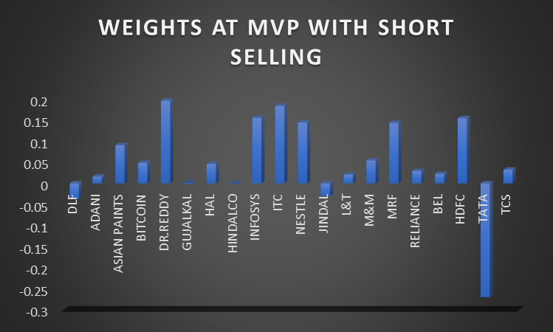
GRAPHICAL REPRESENTATION OF WEIGHTS

Slide 32
MARKET MODEL ANALYSIS (USING PYTHON)

Slide 33
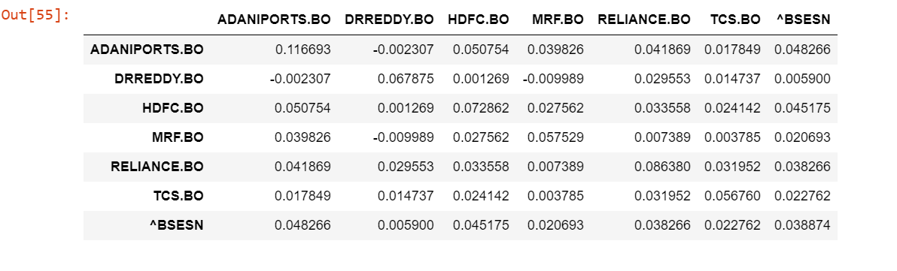
Python Results
VARIANCE COVARIANCE MATRIX

Slide 34
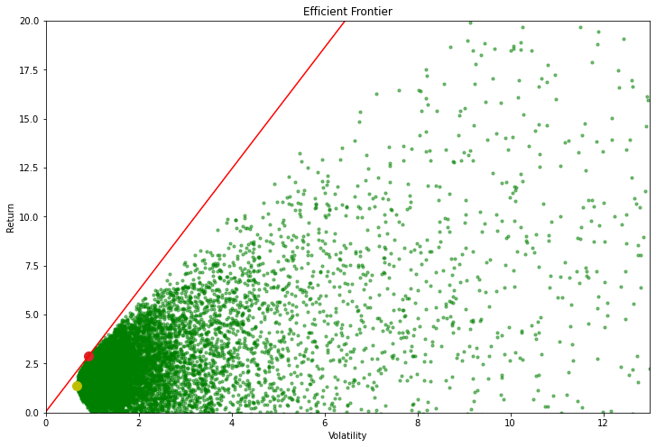
Efficient Frontier
YELLOW POINT- Minimum Volatility
RED POINT – Optimum Tangency

Slide 35


